Slide 1
EE227 – Digital Logic Design
Lecture 15

Slide 2
Outline
Decimal Adder
BCD Adder
Magnitude Comparator
Decoder
3 to 8 line decoder
2 to 4 line decoder with NAND gates
4 to 16 line decoder

Slide 3
Decimal Adder
Computers or calculators that perform arithmetic operations directly in the decimal number system represent decimal numbers in binary coded form
An adder for such a computer must employ arithmetic circuits that accept coded decimal numbers and present results in the same code
A decimal adder requires a minimum of nine inputs and five outputs
Here we will discuss BCD adder

Slide 4
BCD Adder (1/3)
Consider the arithmetic addition of two decimal digits in BCD, together with an input carry from a previous stage
Since each input digit does not exceed 9, the output sum cannot be greater than 9 + 9 + 1 = 19
When the binary sum is equal to or less than 1001, the corresponding BCD number is identical and no correction is required
When the binary sum is greater than 1001, we obtain an invalid BCD representation
The addition of binary 6 (0110) to the binary sum converts it to the correct BCD representation and also produces an output carry as required

Slide 5
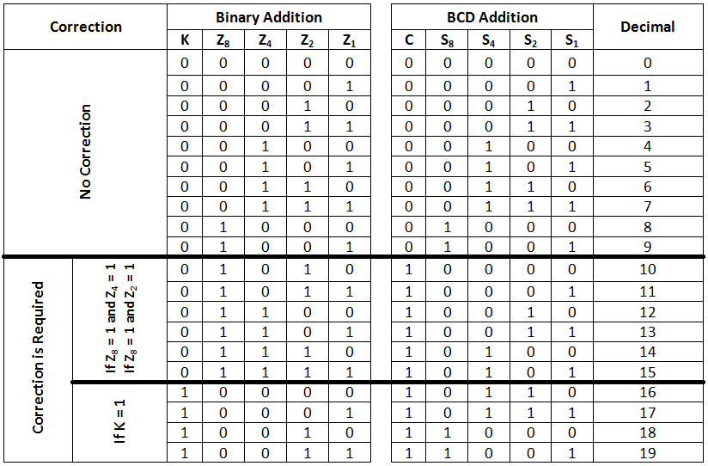
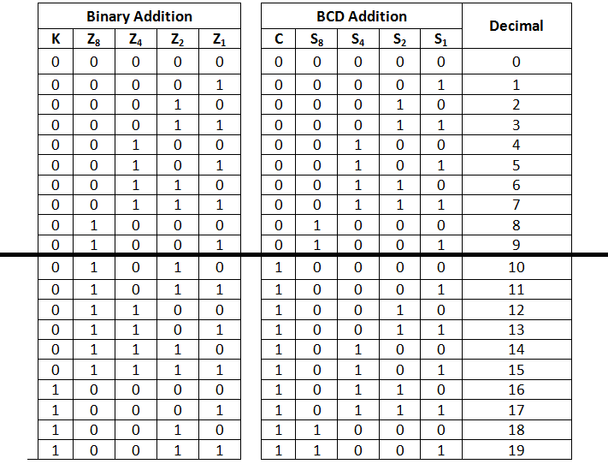
BCD Adder (2/3)
C = K + Z₈Z₄ + Z₈Z₂

Slide 6
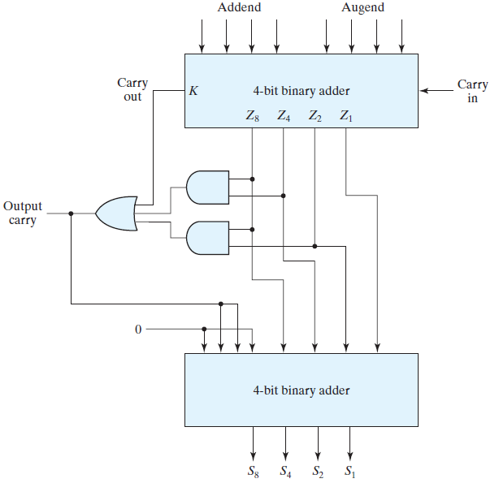
BCD Adder (3/3)

Slide 7
Magnitude Comparator (1/4)
The comparison of two numbers is an operation that determines whether one number is greater than, less than, or equal to the other number
A magnitude comparator is a combinational circuit that compares two numbers A and B and determines their relative magnitudes
The outcome of the comparison is specified by three binary variables that indicate whether A < B, A = B, or A > B
With conventional method, the circuit for comparing two n bit numbers has 2^{2n} entries in the truth table and becomes too cumbersome, even with n = 3
We will use another algorithm that will simplify the design

Slide 8
Magnitude Comparator (2/4)
Consider two numbers, A and B , with four digits each
Write the coefficients of the numbers in descending order of significance:
A = A₃ A₂ A₁ A₀ B = B₃ B₂ B₁ B₀
The two numbers are equal if all pairs of significant digits are equal
It can be checked with XNOR operation
x_{i} = A_{i}B_{i} + A’_{i} B’_{i} for i = 0, 1, 2, 3
The binary output variable (A = B) is equal to 1 only if all pairs of digits of the two numbers are equal
(A = B) = x₃x₂x₁x₀

Slide 9
Magnitude Comparator (3/4)
To determine whether A is greater or less than B , we inspect the relative magnitudes of pairs of significant digits, starting from the most significant position
If the two digits of a pair are equal, we compare the next lower significant pair of digits
The comparison continues until a pair of unequal digits is reached
If the corresponding digit of A is 1 and that of B is 0, we conclude that A > B
If the corresponding digit of A is 0 and that of B is 1, we have A < B
(A > B) = A₃B’₃ + x₃A₂B’₂ + x₃x₂A₁B’₁ + x₃x₂x₁A₀B’₀
(A < B) = A’₃B₃ + x₃A’₂B₂ + x₃x₂A’₁B₁ + x₃x₂x₁A’₀B₀

Slide 10
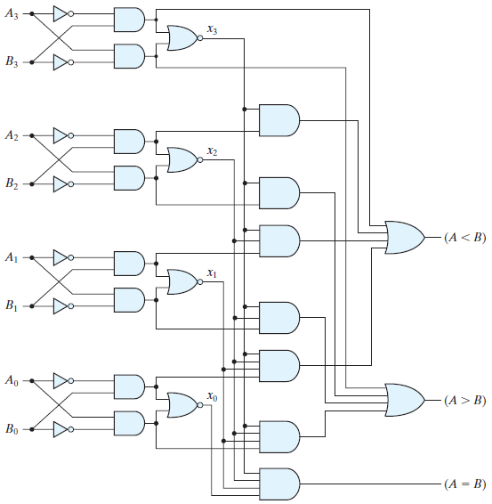
Magnitude Comparator (4/4)

Slide 11
Decoders
Discrete quantities of information are represented in digital systems by binary codes
A binary code of n bits is capable of representing up to 2^{n} distinct elements of coded information
A decoder is a combinational circuit that converts binary information from n input lines to a maximum of 2^{n} unique output lines
If the n bit coded information has unused combinations, the decoder may have fewer than 2^{n} outputs
The decoders presented here are called n to m line decoders, where m ≤ 2^{n}
Their purpose is to generate the 2^{n} (or fewer) minterms of n input variables

Slide 12
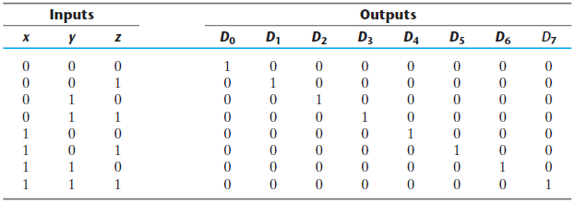
3 to 8 Line Decoder (1/2)
In 3 to 8 line decoder the three inputs are decoded into eight outputs, each representing one of the minterms of the three input variables
A particular application of this decoder is binary-to-octal conversion
However, a three-to-eight-line decoder can be used for decoding any three-bit code to provide eight outputs, one for each element of the code

Slide 13
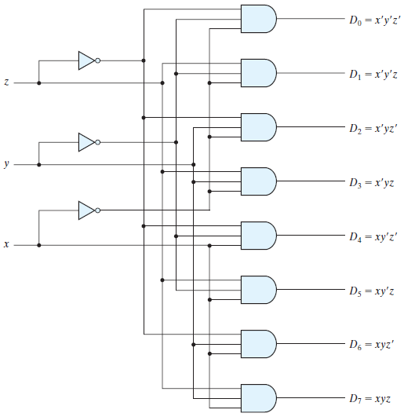
3 to 8 Line Decoder (2/2)

Slide 14
Decoders with NAND Gates
Some decoders are constructed with NAND gates
Since a NAND gate produces the AND operation with an inverted output, it becomes more economical to generate the decoder minterms in their complemented form
Furthermore, decoders include one or more enable (E) inputs to control the circuit operation
The decoder is enabled when E is equal to 0

Slide 15
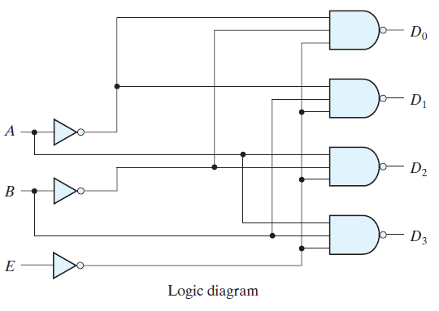
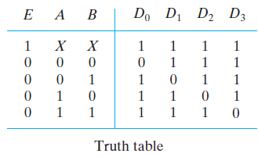
2 to 4 Line Decoder with NAND

Slide 16
Decoder with Enable Input
In general, a decoder may operate with complemented or un-complemented outputs
The enable input may be activated with a 0 or with a 1 signal
Some decoders have two or more enable inputs that must satisfy a given logic condition in order to enable the circuit

Slide 17
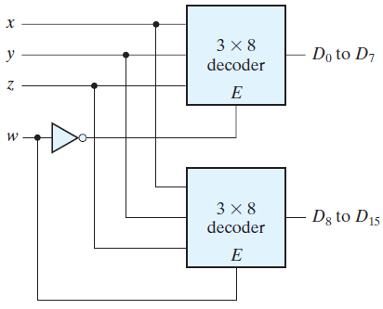
4 to 16 Line Decoder
Two 3-to-8-line decoders with enable inputs connected to form a 4-to-16-line decoder
When w = 0, the top decoder is enabled and the other is disabled
The bottom decoder outputs are all 0’s, and the top eight outputs generate minterms 0000 to 0111
When w = 1, the enable conditions are reversed, the bottom decoder outputs generate minterms 1000 to 1111, while the outputs of the top decoder are all 0’s

